Slide 1
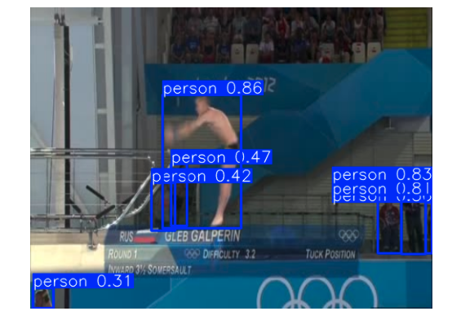
FineDiving-Process of Tracking
Downloaded the data and explored(last meeting)
Ran Co-tracker on whole video. Use YOLO to find the box(there were multiple detection from Yolo)
How to find only 1 object? Calculated the area and selected the box with maximum area.
Distribution of 1000 points uniformly.
As in the dataset for 1 video, there are more than 1 actions like Entry, 2.5 Soms.Pike, Back, Forward, 3.5 Soms.Tuck", and more. Total of 29 different actions.

Slide 2
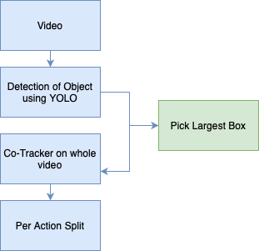
Process of Tracking-Continued…
As first frame were annotated, so ran co-tracker and then saved the video. Further to save Tracking tensor and Visibility, I saved it per action in a video.(Saved pred_tracks, pred_visibility, label and shape_info)
Saving these tensors in their exact size was leading to a pt file to be more than 250mb(There are in total of 9380 pt files), so flattened.
As it worked for 2815 videos, out of 3000.
For 185 videos, Yolo was unable to find object.

Slide 3
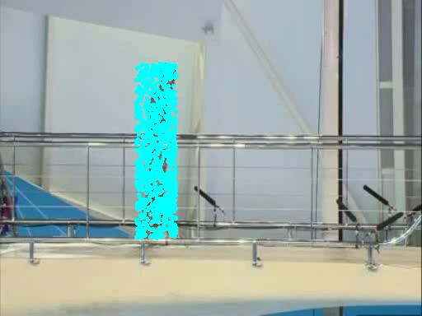
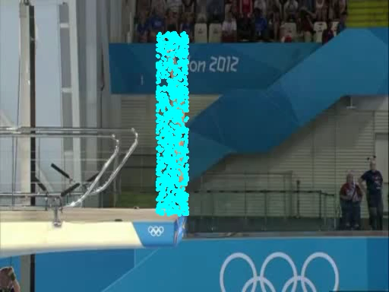
Example Tracked Video

Slide 4
Difference per class is optimal for not tracked video. 673 pt files in total out of 10053 class(~6%).
Should I Track lost video manually or leave it because of pt class difference(To be shown).
 | Original | Preprocessed | Lost
Train | 2251 | 2124 | 127
Test | 749 | 704 | 45

Slide 5
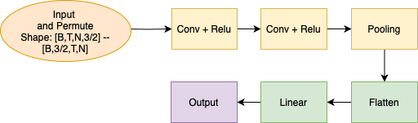
Model Creation
We have dataset and train-test split given in dataset. So, trained on basic CNN model.

Slide 6
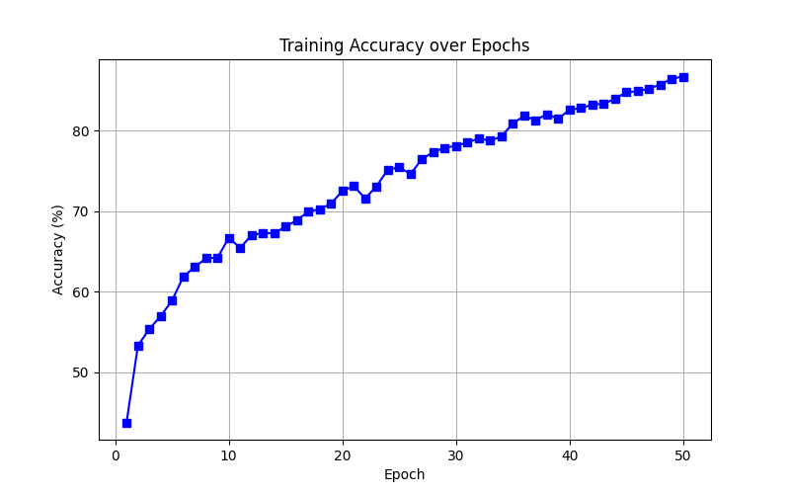
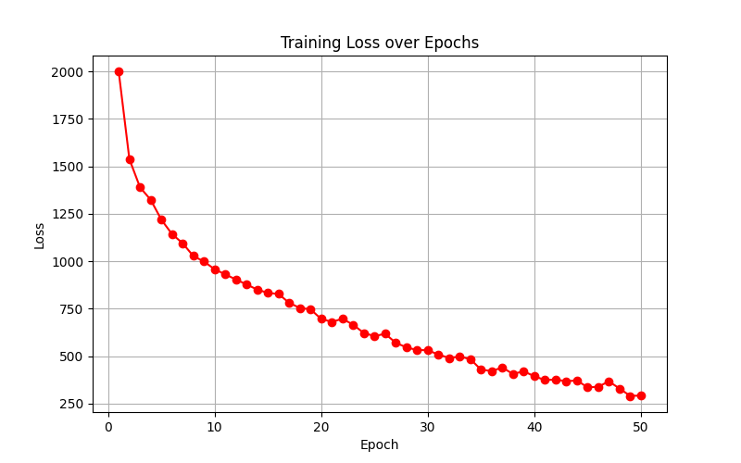
Training and Results.
 | #s of pts | Accuracy
Train | 7021 | 86.4
Test | 2359 | 71.22

Slide 7
Training and Results-Continued…
Per class precession, recall and confusion matrix are also saved. Balanced the class as there were some actions which are just 1. Kept it for Understanding the model
For this models training, I have used both tracks and visibility by concatenating along last dimension to form [T,N,3].
To be shown:
Test Confusion metrics
Same model results on just tracking.

Slide 8
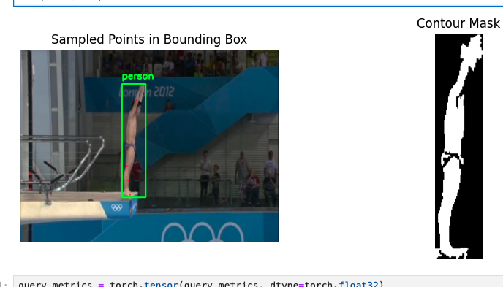
What to do next?
I have thought that I will also annotate it using a contour-based method by first cropping the box region from each frame, converting it to grayscale, applying adaptive thresholding to highlight edges, and then detecting object boundaries using Contours.
Can also be used to study dense tracked vs sparse tracked motion patterns, as for this, I will only track 10–15 key points instead of using dense point tracking.

Slide 9
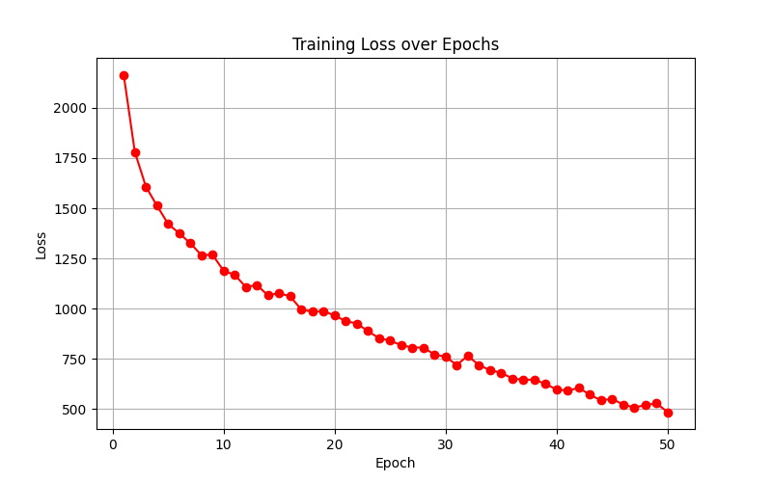
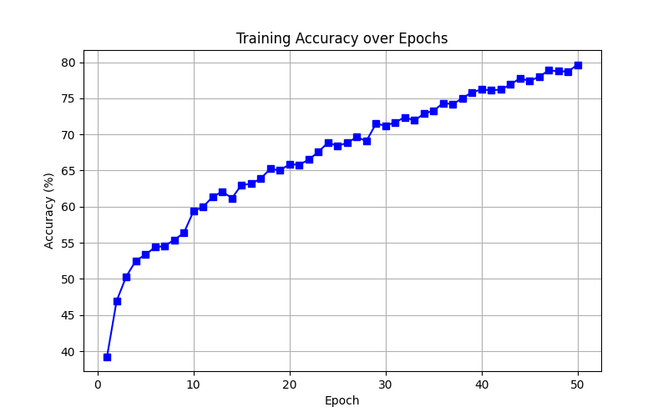
Only Tracking results[T,N,2]
 | Accuracy
Train | 79.66
Test | 67.36

Slide 10
Questions
How can we only select the points that “matter” for dense dataset?
How can I visually represent and understand motion centric tracking points?
What to do next ?

